Slide 1
Process Orchestration
Dr David Wyatt

Slide 2
Session Plan
Introduction
What is process orchestration
Why it is important
Challenges of broken, disconnect processes
When do you need process orchestration?
Advanced workflow patterns
Process orchestration and the automation

Slide 3
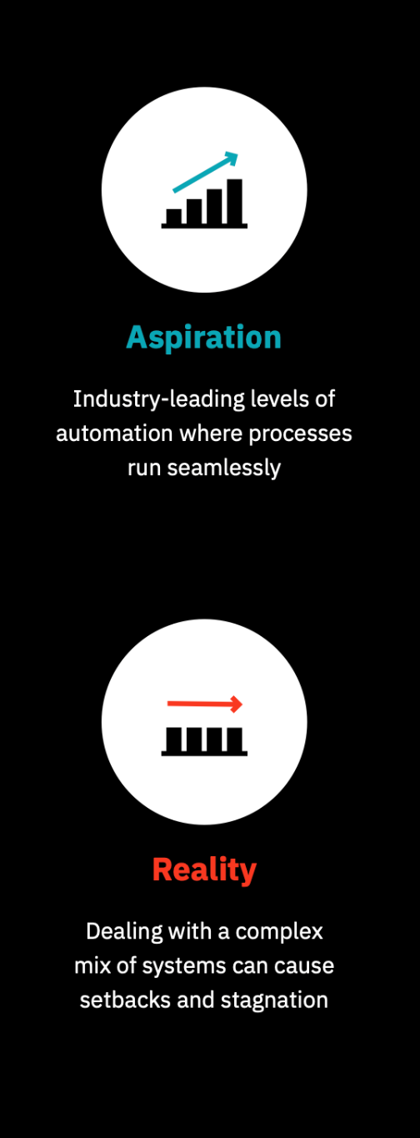
Introduction
Many businesses aim for seamless, end-to-end automation across people, systems, and devices.
Startups can more easily achieve this level of automation compared to established companies dealing with legacy systems.
Legacy system modernisation is a top strategic priority for 70% of global companies*.
Replacing legacy systems is often costly and disruptive for organisations.
Process Orchestration helps address challenges posed by legacy systems, diverse process endpoints, and operational silos.
Notes:
*Tata Consultancy Services and AWS. 70 percent of global CXOs see mainframe and legacy
modernisation as top business priority: TCS survey, February 2021.

Slide 4
What is Process Orchestration?
Process Orchestration manages the coordination of various elements or endpoints within a business process.
It can also link multiple processes together, ensuring seamless operation.
By facilitating collaboration with existing personnel, systems, and devices, process orchestration enhances operational efficiency.
It supports the achievement of ambitious goals related to end-to-end process automation.

Slide 5
Why it is important (Example)
Improve customer experience/satisfaction
Reduce wastage
Improve efficiency and productivity
Improve quality of service
Reduce conflicts
Improve transparency

Slide 6
Why it is important (Example)...
Example Case study:
Kate orders some tile online from a flooring retailer for her bathroom renovation. While she browses, she confirms that the tile she selects is available at her local store for same-day pickup. So, she selects the “Pick up in store” option at checkout on the website. She receives an email saying that her order will be prepared within two hours. Before driving to the store a few hours later, she calls to check that her tile is available, since she never got an additional email or text confirmation that her order was ready for pickup. The customer service representative checks the order fulfilment system and tells her that she is actually fifth in line for in-store pickup, and that her order won’t be ready until mid-day tomorrow.

Slide 7
Challenges of broken, disconnect processes
Incomplete end-to-end automation:
  Localised automations are not interconnected, resulting in the end-to-end process being only partially automated (as seen in the ecommerce example).
Limited understanding:
  The full end-to-end process lacks visibility, making it difficult to track key performance metrics effectively.
Reduced flexibility:
  Altering the end-to-end process is challenging, as it may require changes across multiple systems.
  “It’s critical to overcome these challenges to increase the degree
  of automation in your organisation. Process orchestration is what you need to make that happen.”

Slide 8

When do you need process orchestration?
Endpoint diversity
  Every process is composed of tasks, and executing the process requires coordinating the execution of these tasks.
  Process orchestration software manages the execution of the process but does not perform the tasks directly.
  Tasks are executed by endpoints, which can be people, software systems, or physical devices.
  The more diverse the endpoints, the greater the need for robust process orchestration software that allows for quick and flexible integration of those endpoints.
  For instance, individuals may be using various front-end devices or different applications that execute tasks when triggered via an API.

Slide 9
When do you need process orchestration? Count…
Process complexity
  Coordinating the execution of tasks is essential for executing a process, as previously mentioned.
  Coordination is based on specific logic, which, in practice, is rarely a simple linear sequence of steps.
  Process logic is often more intricate and requires detailed description through advanced workflow techniques.
Challenges in dealing with process complexity
  Alignment:
    Collaboration between technical and non-technical stakeholders is essential for designing, operating, and improving complex end-to-end processes.
    Achieving this collaboration can be challenging due to differing expertise and perspectives.
  Scalability and Resilience:
    Processes must be executed reliably and scaled to handle spikes, such as surges in ecommerce orders across systems and personnel.
    Orchestrators must ensure high availability by running orchestration logic redundantly across multiple data centres.

Slide 10
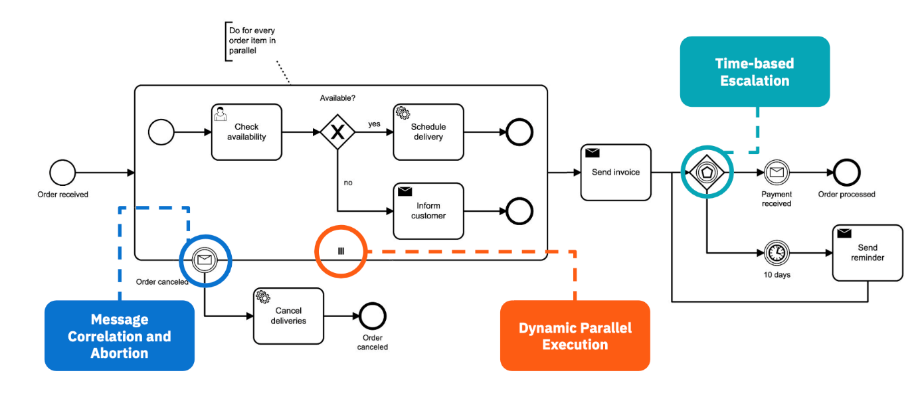
Advanced workflow patterns
Largely end-to-end process automation limited to basic workflow patterns
  Steps in a sequence
  Branches for if/then-based processes
  Parallel execution of steps
This is sufficient for local task automation
  E.g. work that an application user does in the user interface

Slide 11
Advanced workflow patterns
Examples
Dynamic parallel execution:
  Dynamically coordinating many tasks at the same time
    A home appliance store receives 10 "click and collect" orders through its website. The store must process these orders simultaneously, ensuring the items are reserved for pickup and removed from the online stock. This requires dynamic coordination of multiple tasks as each order is placed.
Message correlation + abortion
  Lack of message correlation
    A customer tries resolving an issue through a company's app but ends up calling customer support. Frustration arises when the agent is unaware of the steps already taken online. The business needs a unique identifier to link the customer's online activity with their phone call, which can be technically difficult to implement on a large scale

Slide 12
Advanced workflow patterns
Examples
Time-based escalation
  Escalating processes that aren’t completed within a specific window of time
    A professional services firm issues an invoice to a customer, and the invoice is not paid on time. An accounting software system prompts the customer to pay the invoice with an automated email coming from the service provider’s business email address. In this case, the process is coordinated across both the firm’s business email and accounting system.

Slide 13
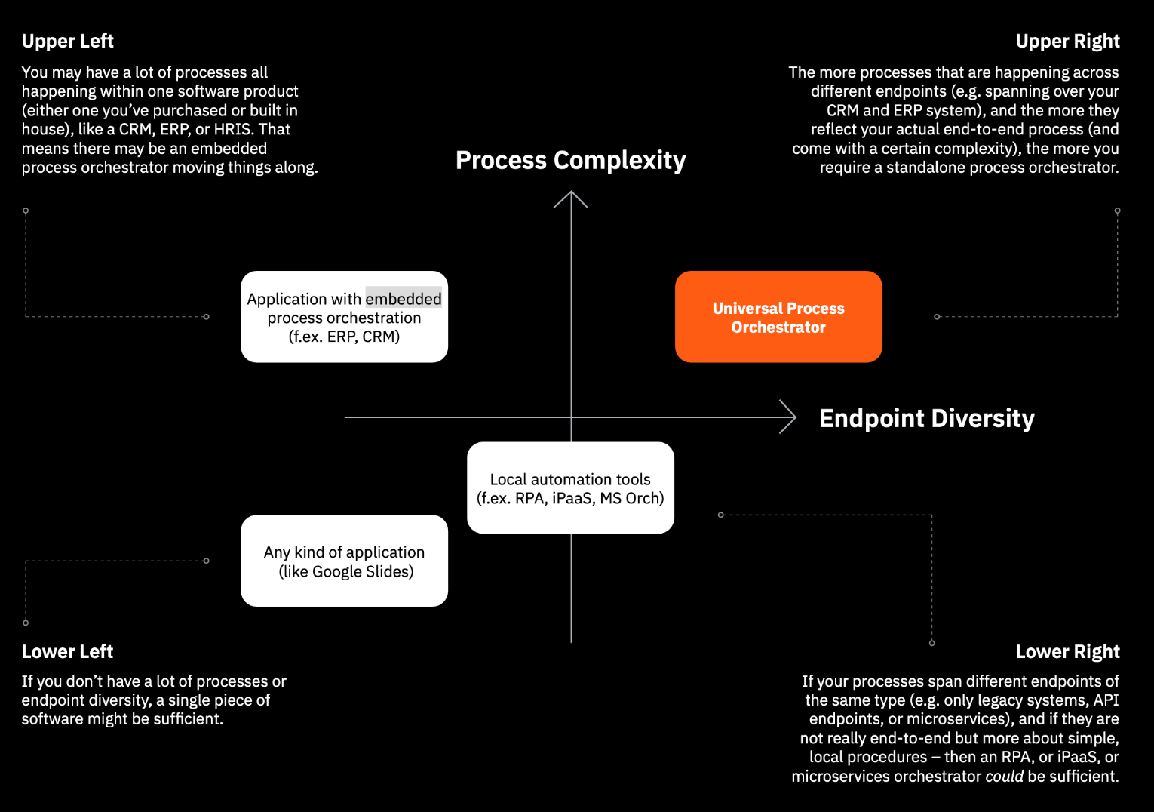
Process orchestration and the automation
Process orchestration is usually combined with other technologies to get complete coverage of your organization’s automation needs.

Slide 14
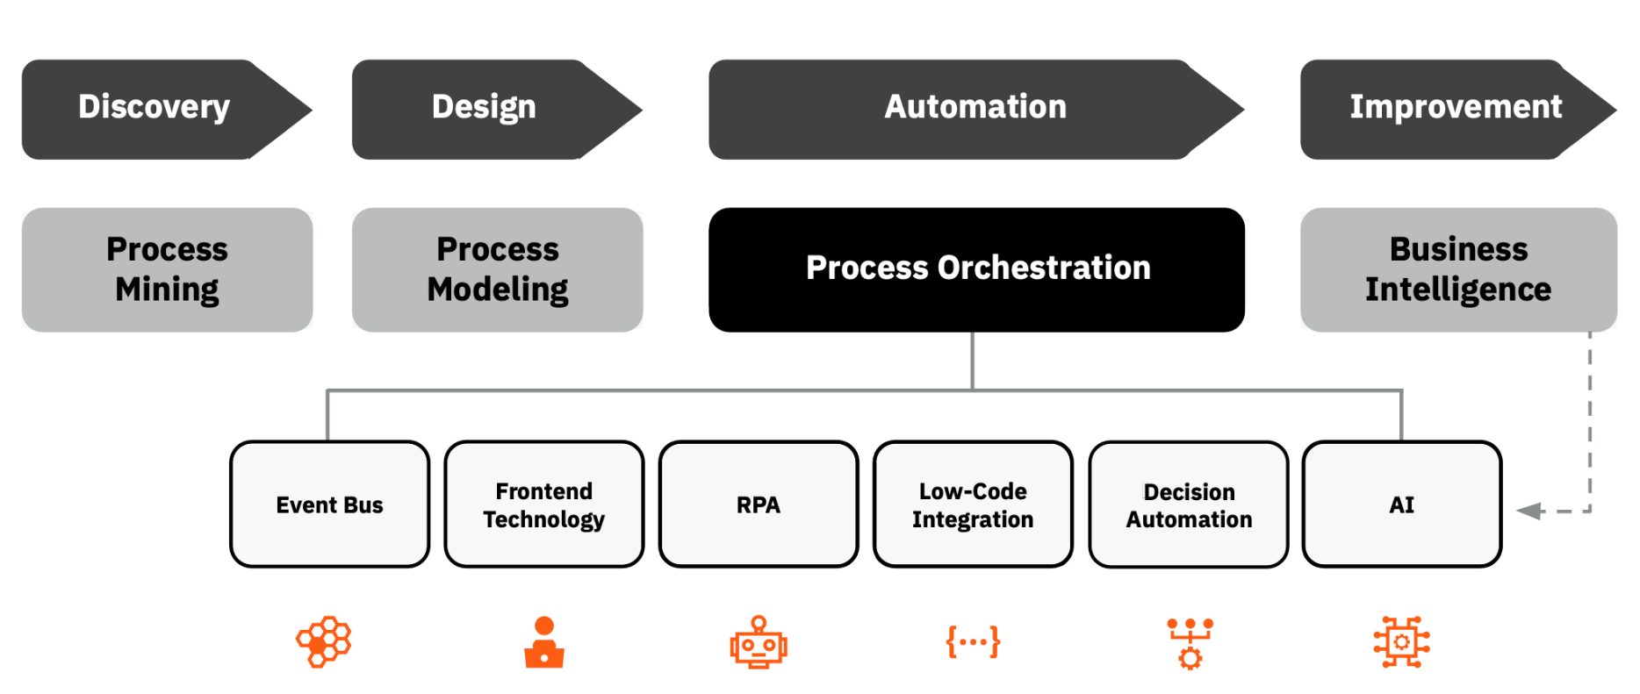
The Hyper-automation Tech Stack

Slide 15

Camunda Why? & How?
Camunda has supported organisations globally in transforming complex business processes involving people, systems, and devices into seamless, scalable customer experiences.
It is designed for universal connectivity, enabling smooth integration with all endpoints involved in end-to-end business processes, including microservices and legacy systems.
Camunda achieves this through a connectivity ecosystem, featuring built-in connectors and an integration framework to speed up connector creation.
These connectors can be reused in a low-code modelling environment, further enhancing flexibility and efficiency.

Slide 16

Any questions?
Thank you for your attention
Dr David Wyatt

